Slide 1


Understanding Unstructured Data
and Data Mining
Abdullah Abbas
Microsoft MVP Data Platform
doli@doli.us

Slide 2
Lemmi brag about myself
- Head of Engineering, Digi-X
- Big Data Team Lead for iProperty Group
We crunch data for more than 2 million data points per day
We introduce a live data statistics for our agents
We introduce insights for property areas
We did a customer churn analysis
We come up with ipropertyiq.com
National Big Data Judges for 2015
MVP for Data Platform
Talking a lot on Microsoft Azure Machine Learning and Cognitive Services
Full Stack Developers

Slide 3

Today’s Agenda
Types of Data Analysis (15 minutes)
Tools you can use to analyze data (10 minutes)
A Brief Intro of R ( 15 minutes)
Data Preparation using R(45 minutes)
Analyzing Tweets for Sentiment Analysis Using R (60 minutes)

Slide 4
Live Now!
Types of Data Analysis (15 minutes)

Slide 5
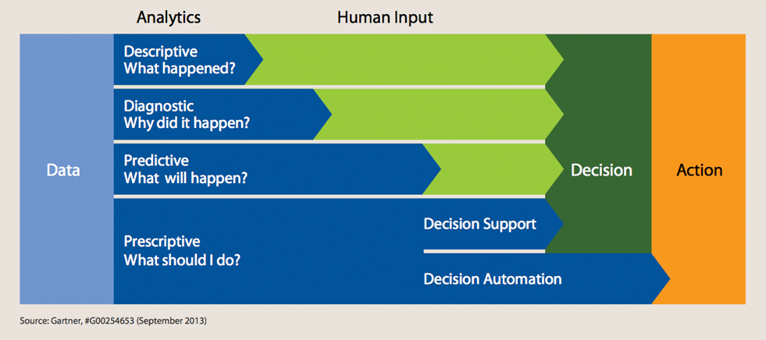
4 TYPES OF ANALYTICS

Slide 6
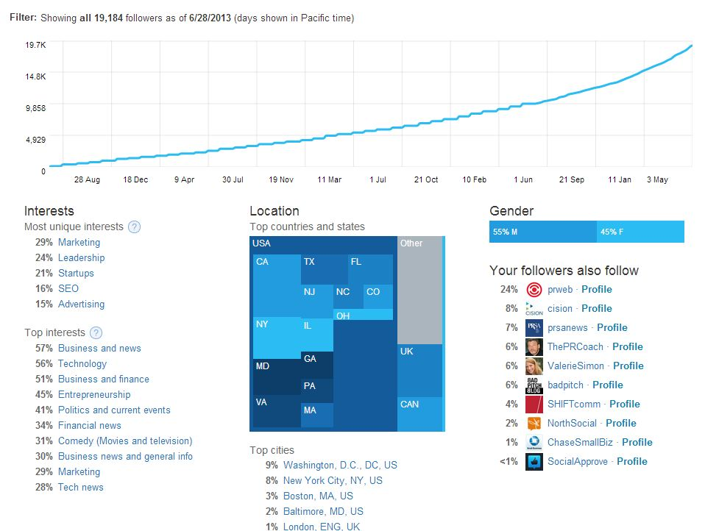
Descriptive Analytics
Summary of historical data to yield useful information and possible to prepare for further analysis

Slide 7
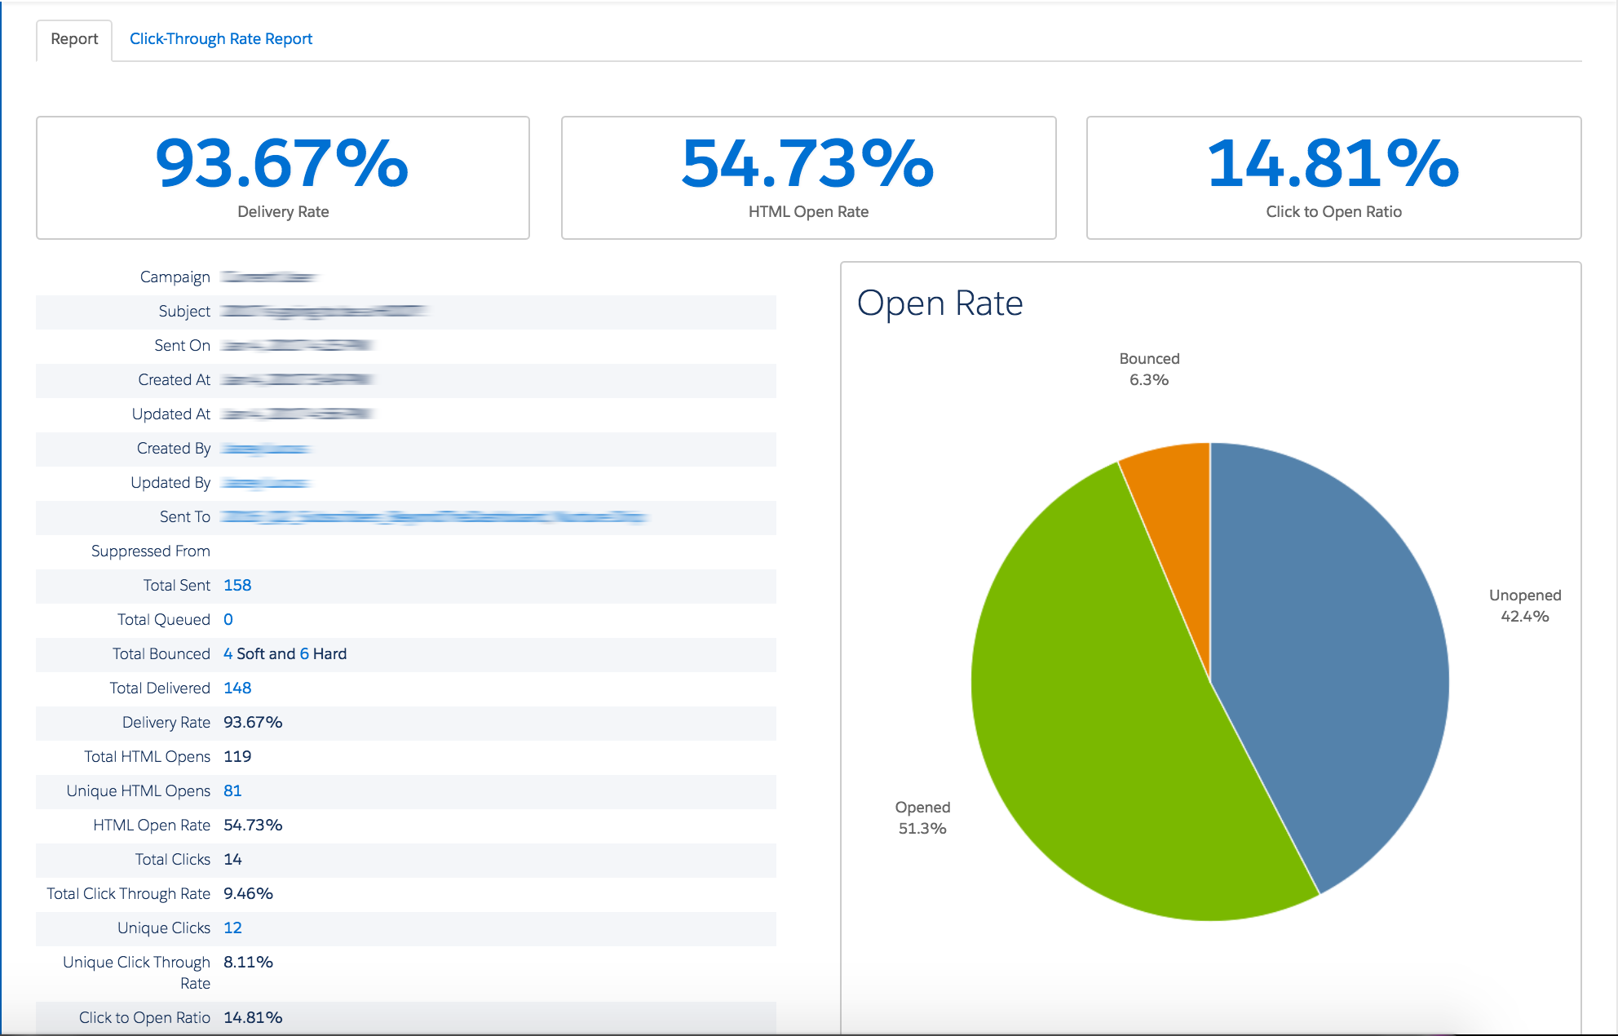
Diagnostic Analytics
A look at past performance to determine what happened and why. The result of the analysis is often an analytic dashboard.

Slide 8

Predictive Analytics
Predictive analytics is a form of advanced analytics that uses both new and historical data to forecast future activity, behavior and trends.

Slide 9

Prescriptive Analytics
Prescriptive analytics is the area of business analytics dedicated to finding the best course of action for a given situation.

Slide 10
80% of business-relevant information originated in unstructured form, primarily text

Slide 11
Structured data vs Unstructured Data

Slide 12
Structured Data | Unstructured Data
Represented in a strict format Example : Database data, Excel sheet containing list of students and their details | Data that containing information that is difficult to organize using traditional mechanism Example : Emails, Images, Videos

Slide 13
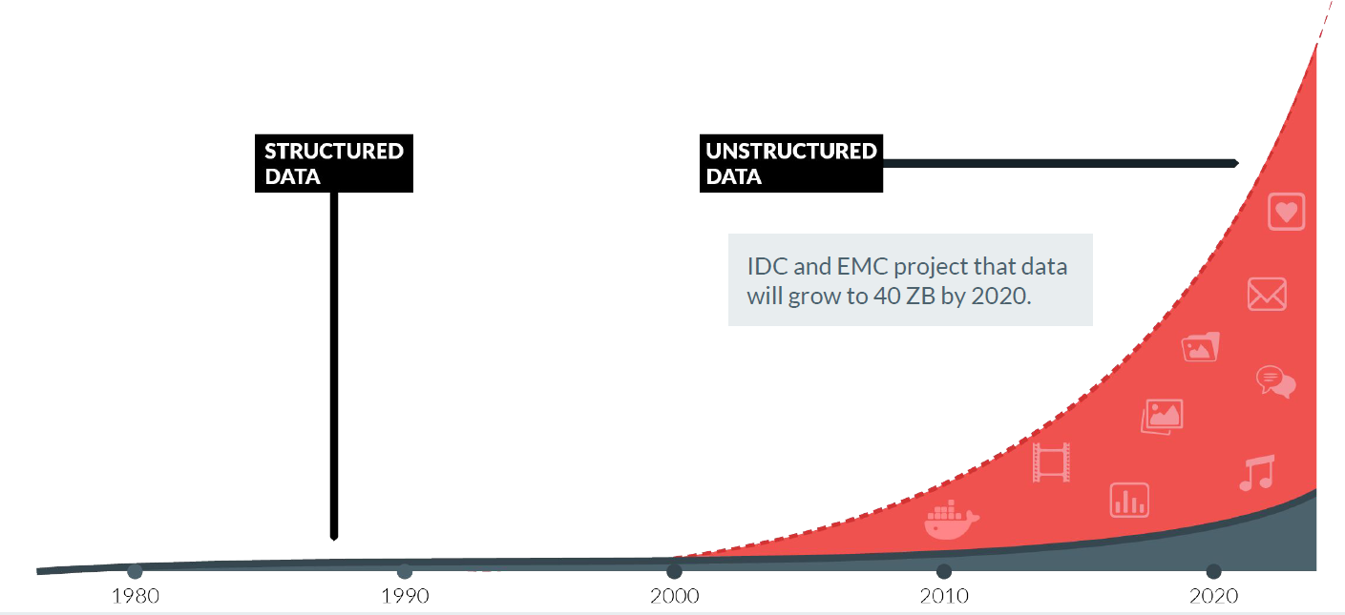
The growth of unstructured data threatens storage (Source: Human Compuer Interaction % Knowledge Discovery

Slide 14
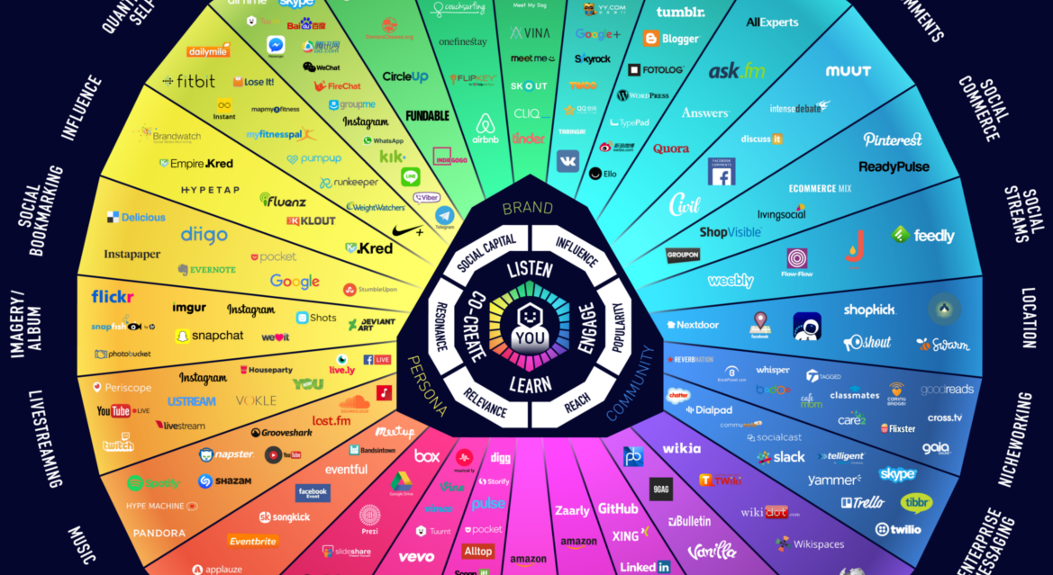

Slide 15
Live Now!
Tools you can use to analyze data (10 minutes)

Slide 16
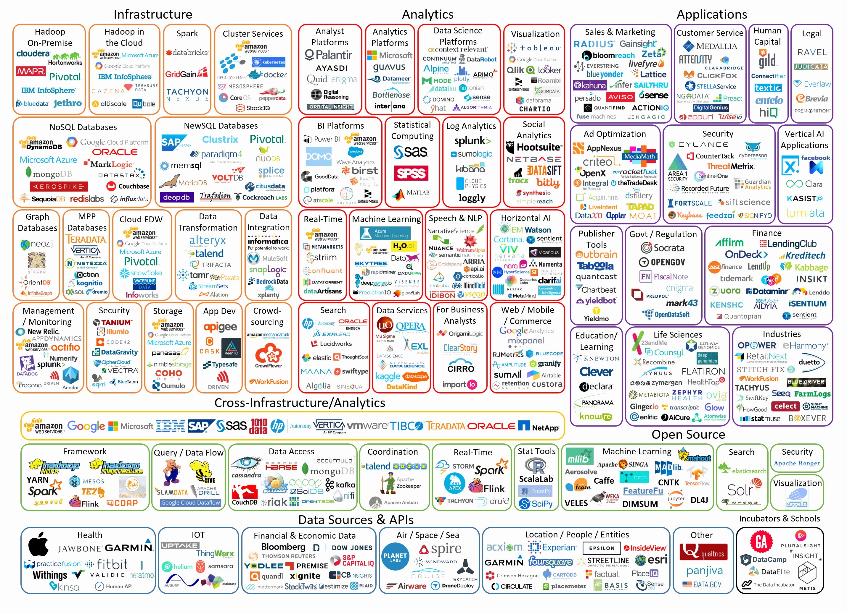

Slide 17
Languages
R
Python
SQL
Java
SAS

Slide 18
Live Now!
A Brief Intro of R ( 15 minutes)

Slide 19
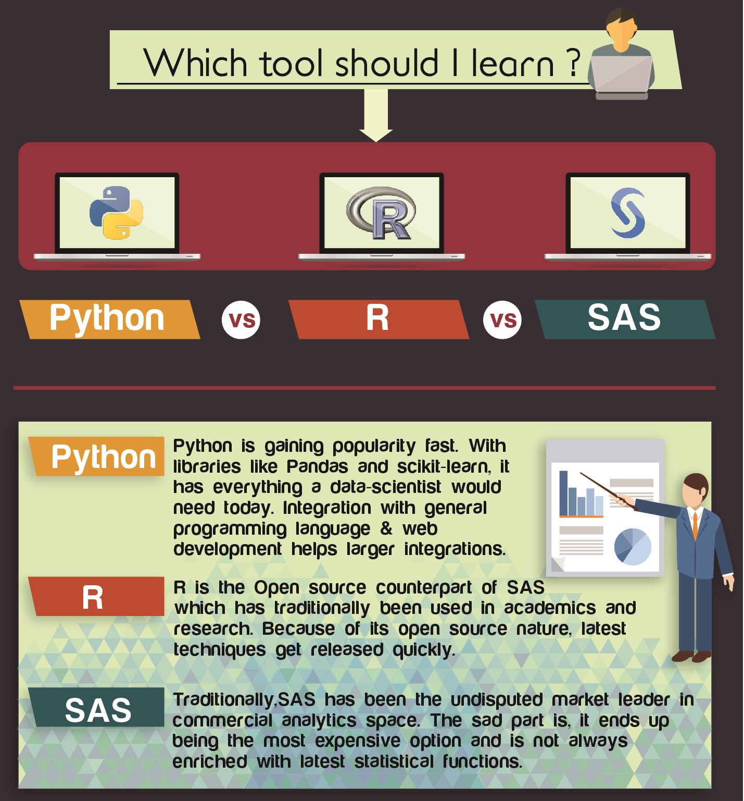

Slide 20
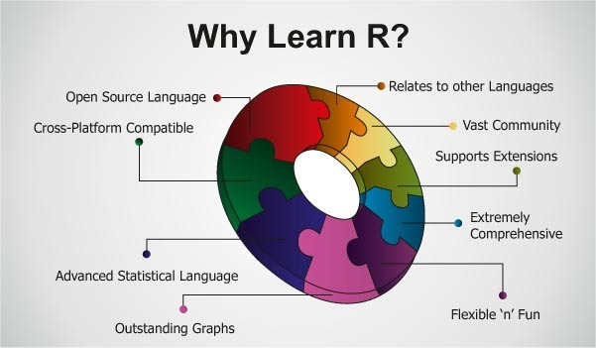

Slide 21
10k + libraries to use
Source : https://cran.r-project.org/web/packages/available_packages_by_name.html

Slide 22
Live Now!
Data Preparation using R(45 minutes)

Slide 23


Slide 24
CrowdFlower, provider of a “data enrichment” platform for data scientists, conducted a survey of about 80 data scientists and found that data scientists spend –
60% of the time in organizing and cleaning data.
19% of the time is spent in collecting datasets.
9% of the time is spent in mining the data to draw patterns.
3% of the time is spent in training the datasets.
4% of the time is spent in refining the algorithms.
5% of the time is spent in other tasks.

Slide 25
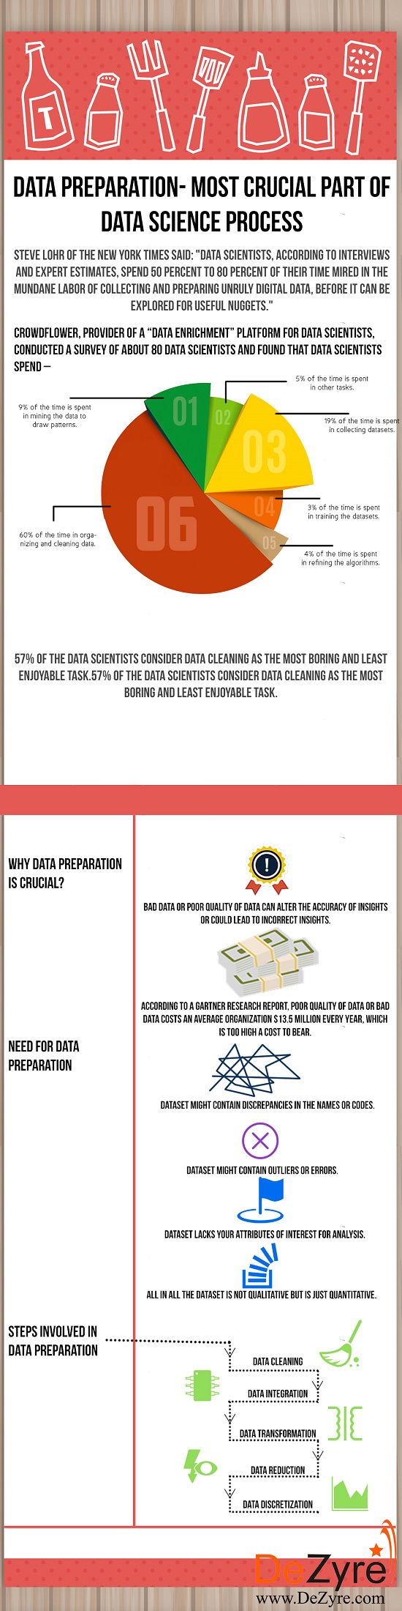

Slide 26
Lets do data preprocessing!
Go to https://github.com/dolicoli/mmu-hol
Or http://d396qusza40orc.cloudfront.net/dsscapstone/dataset/Coursera-SwiftKey.zip
Download EN_US_simple-tweet.txt
Open RStudio

Slide 27
Load Data
> newsFile <- file.choose()
> newsText <- readLines(newsFile)
> vs <- VectorSource(newsText)
> news_corpus <- Corpus(vs, readerControl=list(readPlain, language="en", load=TRUE))

Slide 28
Cleaning Data
Common data cleaning tasks associated with text mining are:
Converting the entire document to lower case
Removing punctuation marks (periods, commas, hyphens etc)
Removing stopwords (extremely common words such as “and”, “or”, “not”, “in”, “is” etc)
Removing numbers
Filtering out unwanted terms
Removing extra whitespace

Slide 29
Converting text to lower case
< news_corpus_proc <- tm_map(news_corpus, content_transformer(tolower))

Slide 30
Removing stopwords
Create function to count Words
countWords <- function(filepath, pattern) {
conn <- file(filepath, "r")
fulltext <- readLines(conn)
close(conn)
count <- 0
for (i in 1:length(fulltext)) {
findr <- gregexpr(pattern, fulltext[i])
if (findr[[1]][1]>0) {
count <- count + length(findr[[1]])
}
}
count
}

Slide 31
Removing stopwords
# Adding the length of the file (in lines) to count the last word in each
# line, which is not surrounded by spaces
totwords <- countWords(newsFile, " * ") + 9616
# Count the ocurrences of very common stopwords
mystopwords <- c(" [Aa]nd ", " [Ff]or ", " [Ii]n ", " [Ii]s ", " [Ii]t ",
" [Nn]ot ", " [Oo]n ", " [Tt]he ", " [Tt]o ")
totstops <- sum(sapply(mystopwords,
function(x) { countWords(newsFile, x) }))
totstops/totwords

Slide 32
Removing stopwords
news_corpus_proc <- tm_map(news_corpus_proc, removeWords,
stopwords(kind="en"))

Slide 33
Removing rest of unnecessary stuff
news_corpus_proc <- tm_map(news_corpus_proc, removePunctuation)
news_corpus_proc <- tm_map(news_corpus_proc, removeNumbers)
news_corpus_proc <- tm_map(news_corpus_proc, stripWhitespace)

Slide 34
Explore the Data
dtm <- DocumentTermMatrix(news_corpus_proc)

Slide 35
Explore the Data
dtm.matrix <- as.matrix(dtm)
wordcount <- colSums(dtm.matrix)
topten <- head(sort(wordcount, decreasing=TRUE), 10)
library(reshape2)
library(ggplot2)
dfplot <- as.data.frame(melt(topten))
dfplot$word <- dimnames(dfplot)[[1]]
dfplot$word <- factor(dfplot$word,
levels=dfplot$word[order(dfplot$value,
decreasing=TRUE)])
fig <- ggplot(dfplot, aes(x=word, y=value)) + geom_bar(stat="identity")
fig <- fig + xlab("Word in Corpus")
fig <- fig + ylab("Count")
print(fig)

Slide 36
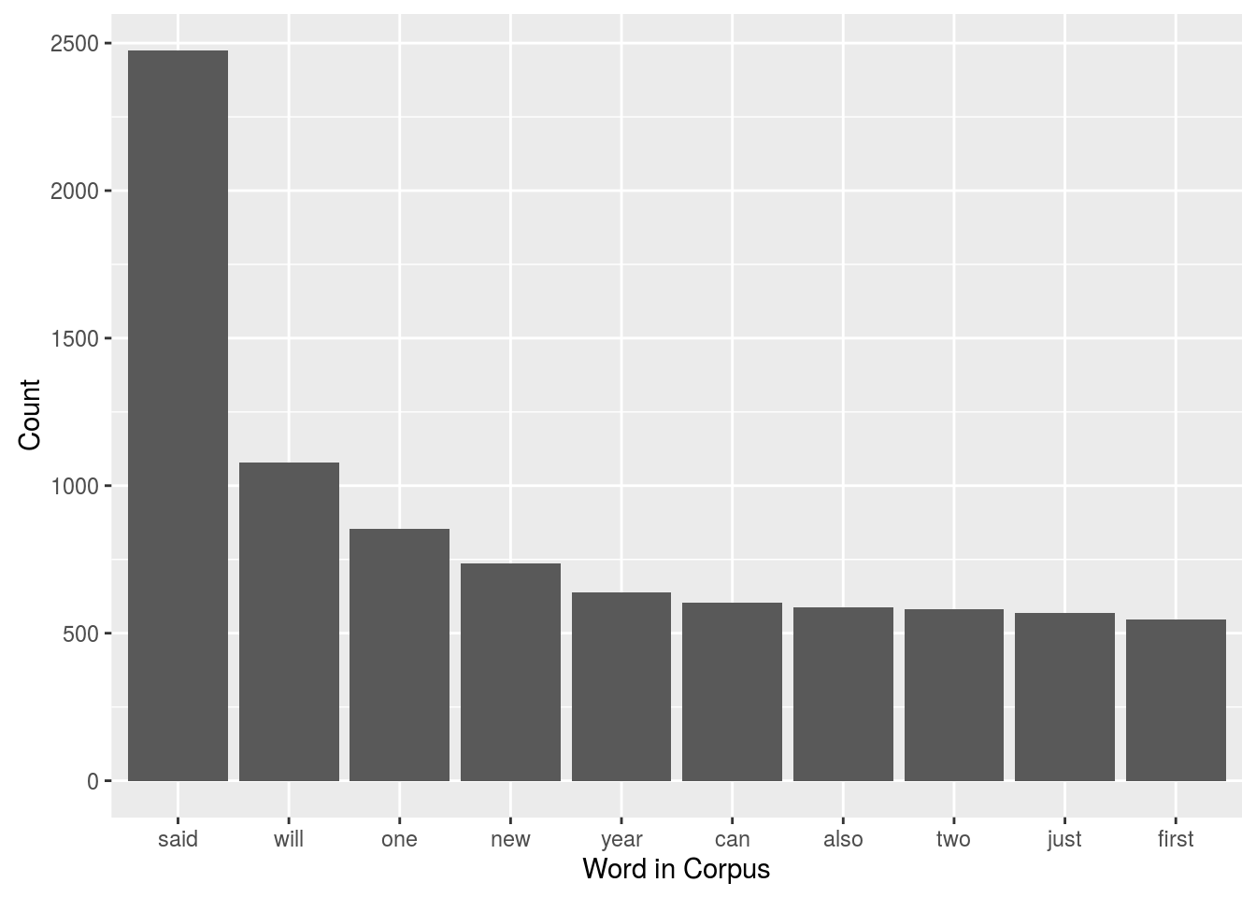

Slide 37
Live Now!
Analyzing Tweets for Sentiment Analysis Using R (60 minutes)

Slide 38
Analyzing Twitter Data with R
Open R Studio
install.packages("RColorBrewer")
install.packages("tm")
install.packages("wordcloud")
install.packages('base64enc')
install.packages('ROAuth')
install.packages('plyr')
install.packages('stringr')
install.packages('twitteR')

Slide 39
Load library
library(RColorBrewer)
library(wordcloud)
library(tm)
library(twitteR)
library(ROAuth)
library(plyr)
library(stringr)
library(base64enc)

Slide 40
Download curl certificate
download.file(url="http://curl.haxx.se/ca/cacert.pem",destfile="cacert.pem")

Slide 41
Set Constant
# Set constant requestURL
requestURL <- "https://api.twitter.com/oauth/request_token"
# Set constant accessURL
accessURL <- "https://api.twitter.com/oauth/access_token"
# Set constant authURL
authURL <- "https://api.twitter.com/oauth/authorize"

Slide 42
Setup Twitter AUTH
setup_twitter_oauth(consumerKey, consumerSecret, accessToken, accessTokenSecret)

Slide 43
Search Twitter
some_tweets = searchTwitter('starbucks', n=1000, lang='en’)
# get the text
some_txt = sapply(some_tweets, function(x) x$getText())

Slide 44
Pre Processing
The preprocessing scripts modifies the tweets content in order to make possible the further analysis.
Any url is removed and substituted with the word "URL"
Any @Username is converted to "AT_USER" to make any tweet anonymous
Any additional white spaces is removed
Ant not alphanumeric symbol is removed
Hashtags are substituted with the corresponding word
The emoticon used for the labeling is stripped out from the text

Slide 45
PreProcessing
# remove retweet entities
some_txt = gsub('(RT|via)((?:\\b\\W*@\\w+)+)', '', some_txt)
# remove at people
some_txt = gsub('@\\w+', '', some_txt)
# remove punctuation
some_txt = gsub('[[:punct:]]', '', some_txt)
# remove numbers
some_txt = gsub('[[:digit:]]', '', some_txt)
# remove html links
some_txt = gsub('http\\w+', '', some_txt)
# remove unnecessary spaces
some_txt = gsub('[ \t]{2,}', '', some_txt)
some_txt = gsub('^\\s+|\\s+$', '', some_txt)

Slide 46
PreProcessing
# define 'tolower error handling' function
try.error = function(x)
{
# create missing value
y = NA
# tryCatch error
try_error = tryCatch(tolower(x), error=function(e) e)
# if not an error
if (!inherits(try_error, 'error'))
y = tolower(x)
# result
return(y)
}

Slide 47
PreProcessing
# lower case using try.error with sapply
some_txt = sapply(some_txt, try.error)
# remove NAs in some_txt
some_txt = some_txt[!is.na(some_txt)]
names(some_txt) = NULL

Slide 48
PreProcessing
if (!require('pacman')) install.packages('pacman&')
pacman::p_load(devtools, installr)
install.Rtools()
install_url('http://cran.r-project.org/src/contrib/Archive/Rstem/Rstem_0.4-1.tar.gz')
install_url('http://cran.r-project.org/src/contrib/Archive/sentiment/sentiment_0.2.tar.gz')

Slide 49
Run Algorithm
# Perform Sentiment Analysis
# classify emotion
class_emo = classify_emotion(some_txt, algorithm='bayes', prior=1.0)
# get emotion best fit
emotion = class_emo[,7]
# substitute NA's by 'unknown'
emotion[is.na(emotion)] = 'unknown'

Slide 50
Get Polarity
# classify polarity
class_pol = classify_polarity(some_txt, algorithm='bayes')
# get polarity best fit
polarity = class_pol[,4]
# Create data frame with the results and obtain some general statistics
# data frame with results
sent_df = data.frame(text=some_txt, emotion=emotion,
polarity=polarity, stringsAsFactors=FALSE)
# sort data frame
sent_df = within(sent_df,
emotion <- factor(emotion, levels=names(sort(table(emotion), decreasing=TRUE))))

Slide 51
Visualize
ggplot(sent_df, aes(x=emotion)) +
geom_bar(aes(y=..count.., fill=emotion)) +
scale_fill_brewer(palette='Dark2') +
labs(x='emotion categories', y='number of tweets') +
ggtitle('Sentiment Analysis of Tweets about Starbucks\n(classification by emotion)') +
theme(plot.title = element_text(size=12, face='bold'))

Slide 52
Visualize
# plot distribution of polarity
ggplot(sent_df, aes(x=polarity)) +
geom_bar(aes(y=..count.., fill=polarity)) +
scale_fill_brewer(palette='RdGy') +
labs(x='polarity categories', y='number of tweets') +
ggtitle('Sentiment Analysis of Tweets about Starbucks\n(classification by polarity)') +
theme(plot.title = element_text(size=12, face='bold'))

Slide 53


Slide 54
Azure Machine Learning
Powerful Machine Learning product with great interface
Load your datasets from different sources
Combining single or multiple algorithm to validate your training
Clean and Modify your data on the go
R, Phyton, OpenCV language supported
Train, Publish your predictive analysis to consume
Combine with other Azure product to be even powerful.

Slide 55
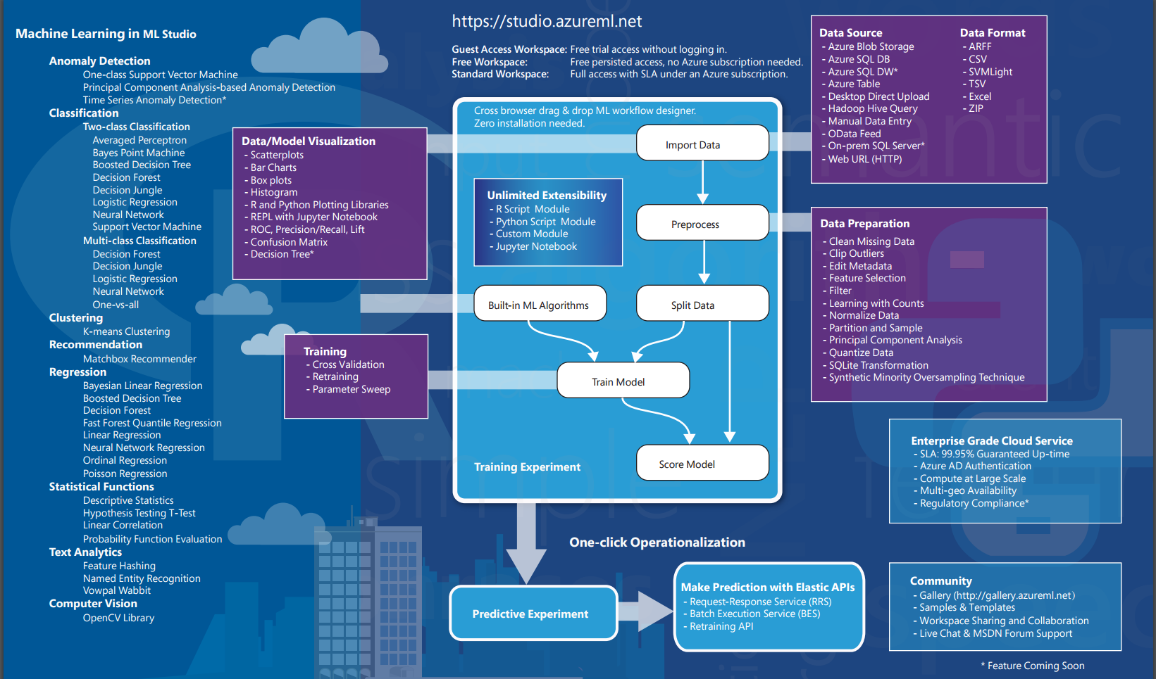

Slide 56
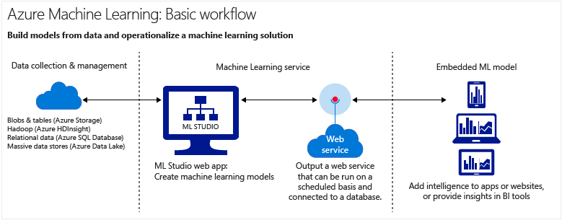

Slide 57
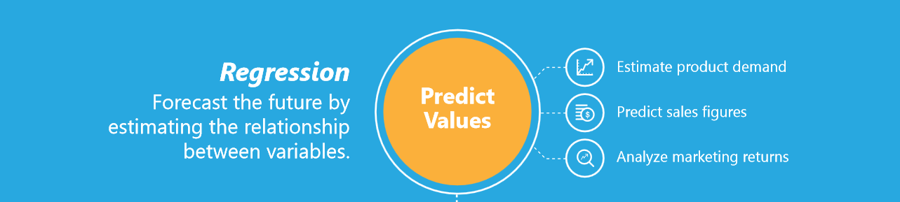
I WANT TO

Slide 58

I WANT TO

Slide 59
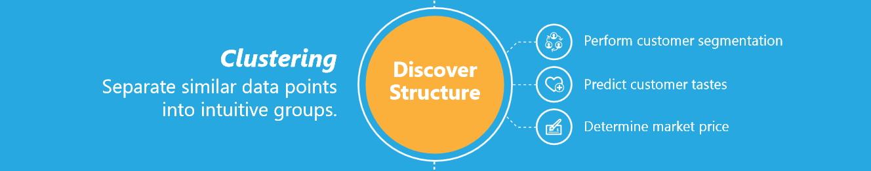
I WANT TO

Slide 60

I WANT TO

Slide 61
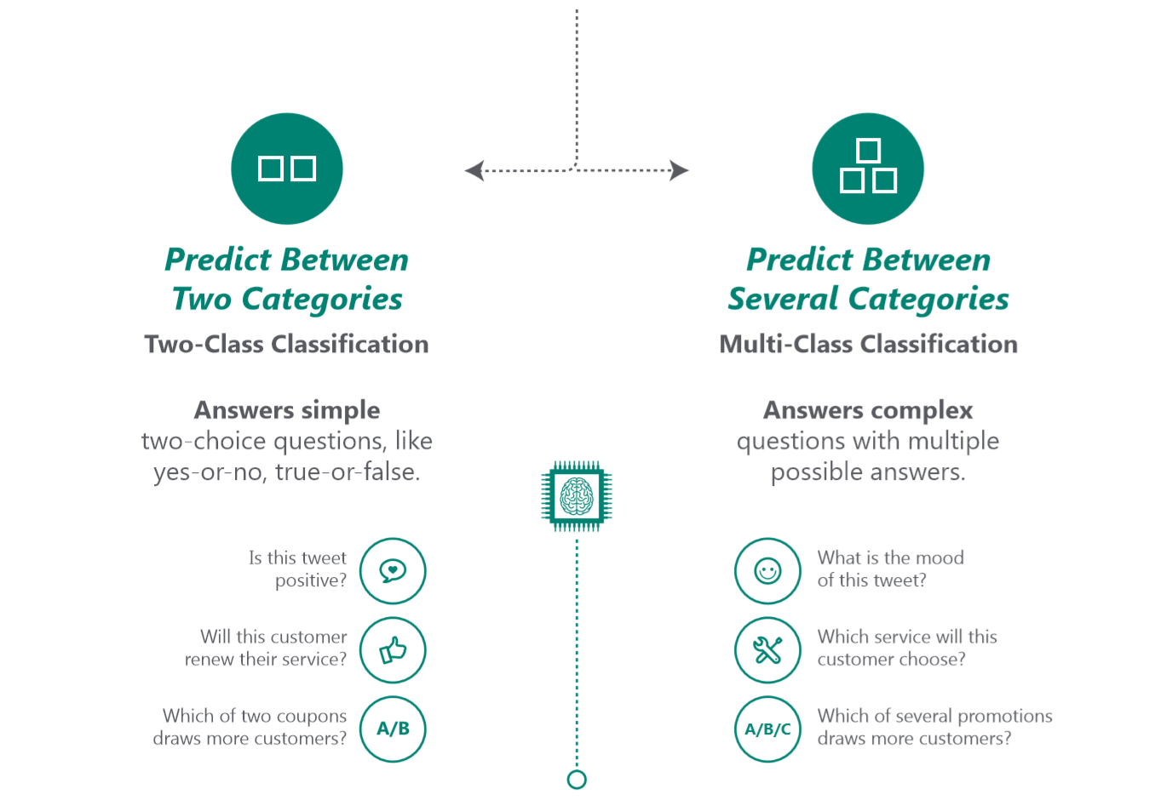

Slide 62
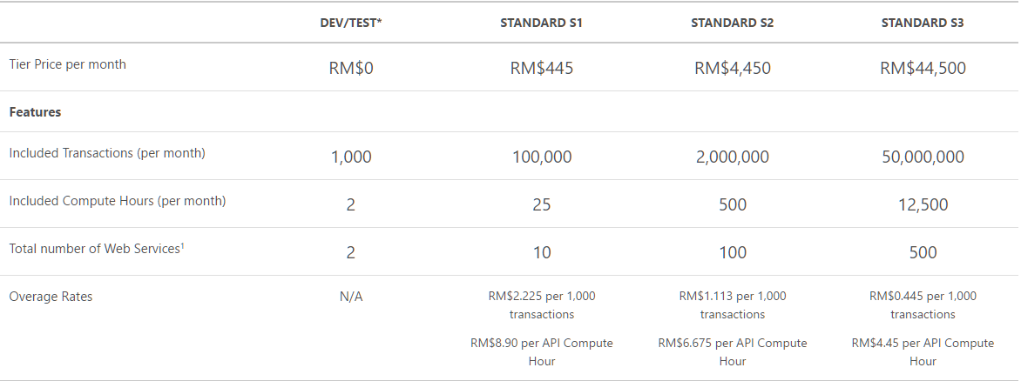
Pricing

